Slide 1


Akshay Babasaheb More
28/10/2021

Slide 2
Outline
Executive Summary
Introduction
Methodology
Results
Conclusion
Appendix
2

Slide 3
Executive Summary
Summary of methodologies: In this project, we used data collection from a CSV file, we preprocessed the data through Data Wrangling techniques, we performed Exploratory Data Analysis through SQL queries and visualization, and created four prediction models, namely SVM, Decision Tree, Logistic Regression and K-nearest Neighbor.
Summary of all results: We found the best estimator came up to be our Decision Tree Classifier.
3

Slide 4

Introduction
SpaceX Falcon 9 first stage Landing Prediction
Request to the SpaceX API
Clean the requested data

Slide 5


Slide 6
Methodology
Executive Summary
Data collection methodology:
Qualitative Data Collection-Online Forum, Group Chat ,Web Survey Chat, Online Communication
Quantitative Data Collection- Face to Face, Phone ,Mail.
Perform data wrangling
Data Acquisition: Identify and obtain access to the data within your sources.
Joining Data: Combine the edited data for further use and analysis.
Data Cleansing: Redesign the data into a usable and functional format and correct/remove any bad data.
Performed exploratory data analysis (EDA) using visualization and SQL

Slide 7
Data Collection
def getBoosterVersion(data): for x in data['rocket’]:
response = requests.get("https://api.spacexdata.com/v4/rockets/"+(x)).json()
BoosterVersion.append(response['name'])
def getPayloadData(data):
for load in data['payloads’]:
response = requests.get("https://api.spacexdata.com/v4/payloads/"+load).json()
PayloadMass.append(response['mass_kg’])
Orbit.append(response['orbit'])

Slide 8
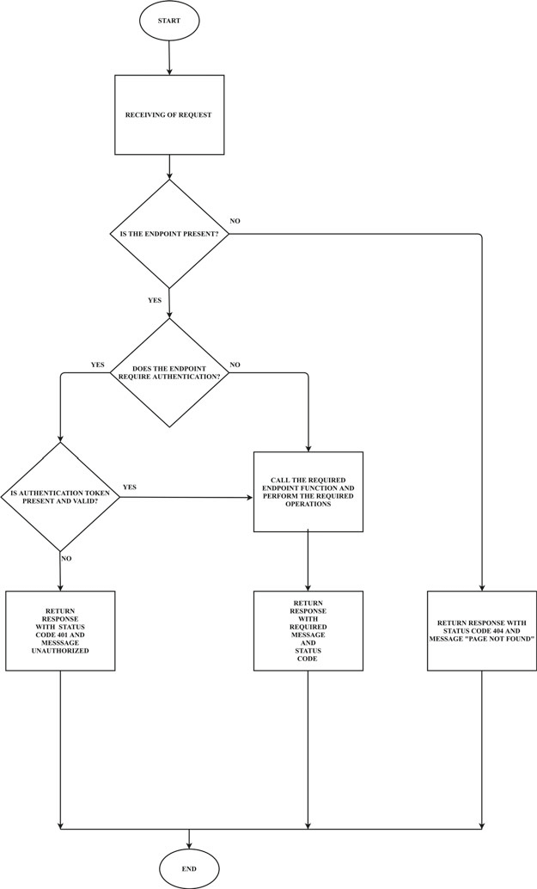
Data Collection – SpaceX API
SpaceX REST calls using key phrases and flowcharts
https://github.com/Akshaymore55/Applied-Data-Science/blob/master/Jupyter-labs-SpaceX-data-collection-API.ipynb
Place your flowchart of SpaceX API calls here

Slide 9
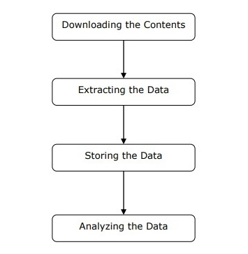
Data Collection - Scraping
Present your web scraping process using key phrases and flowcharts
Place your flowchart of web scraping here

Slide 10
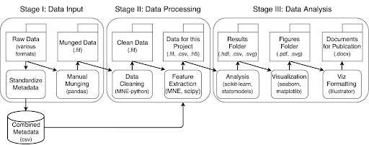
Data Wrangling
Data wrangling is the process of cleaning and unifying messy and complex data sets for easy access and analysis.

Slide 11
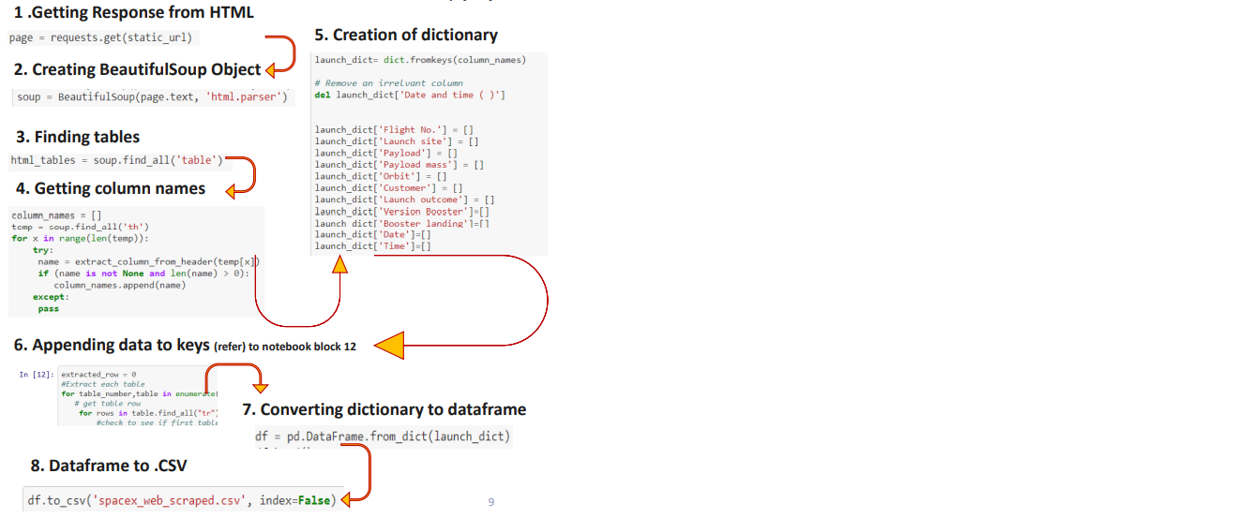
Data Collection with API:-

Slide 12
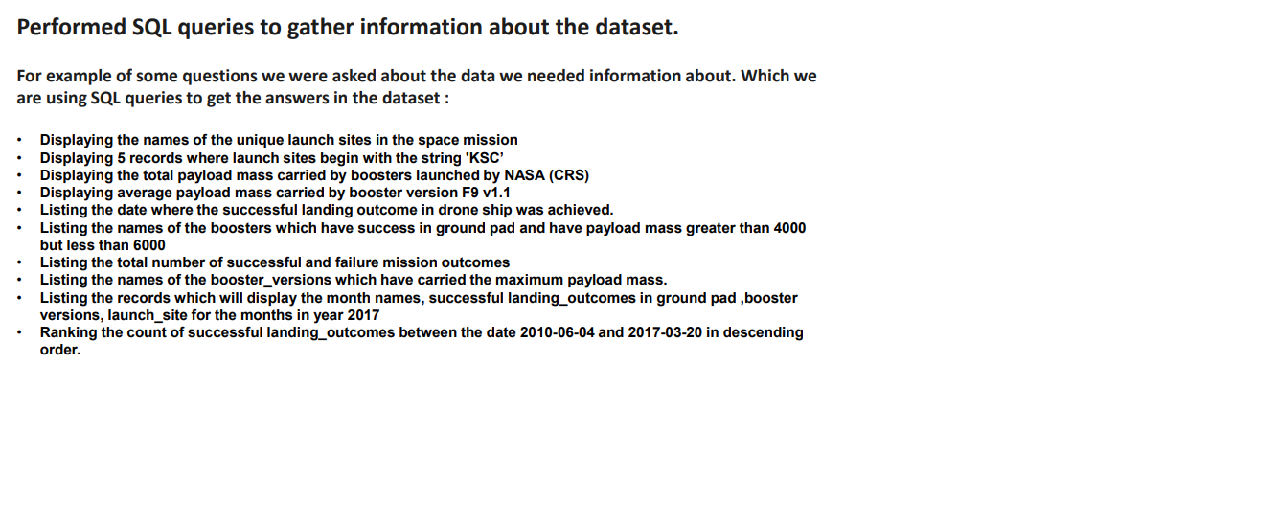
EDA SQL Describe:-

Slide 13
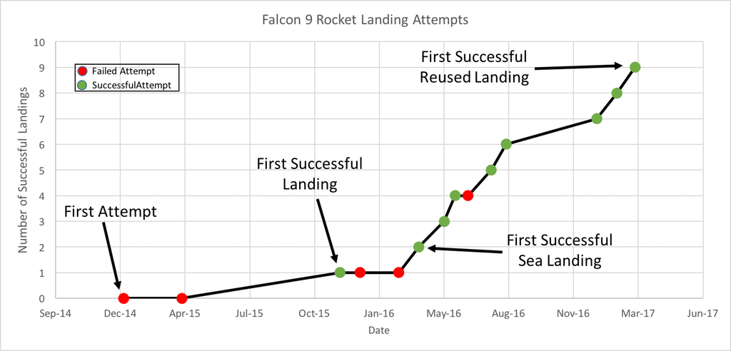
EDA with Data Visualization

Slide 14
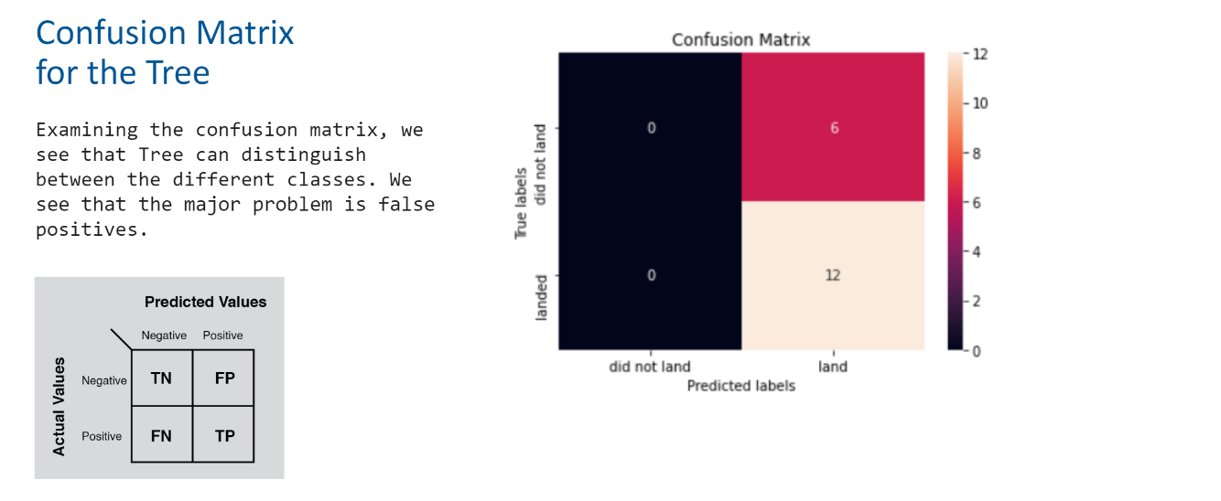
Build an Interactive Map with Folium
Summarize what map objects such as markers, circles, lines, etc. you created and added to a folium map
Explain why you added those objects
Add the GitHub URL of your completed interactive map with Folium map, as an external reference and peer-review purpose

Slide 15
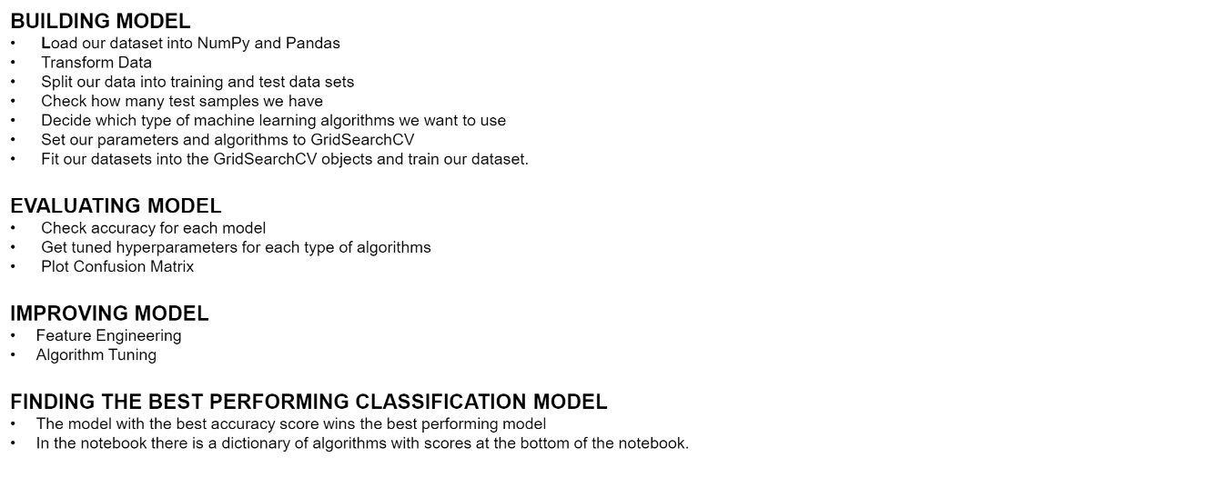
Predictive Analysis (Classification)
Summarize how you built, evaluated, improved, and found the best performing classification model
You need present your model development process using key phrases and flowchart
Add the GitHub URL of your completed predictive analysis lab, as an external reference and peer-review purpose

Slide 16
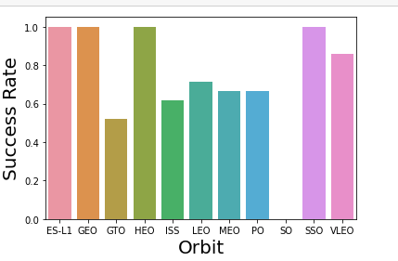
Results
Exploratory data analysis results, we processed the data, explored it, and
applied one hot encoding:
The result of the predictive analysis tells us that We found the best estimator
came up to be our Decision Tree Classifier, with a score of 0,8889.

Slide 17


Slide 18
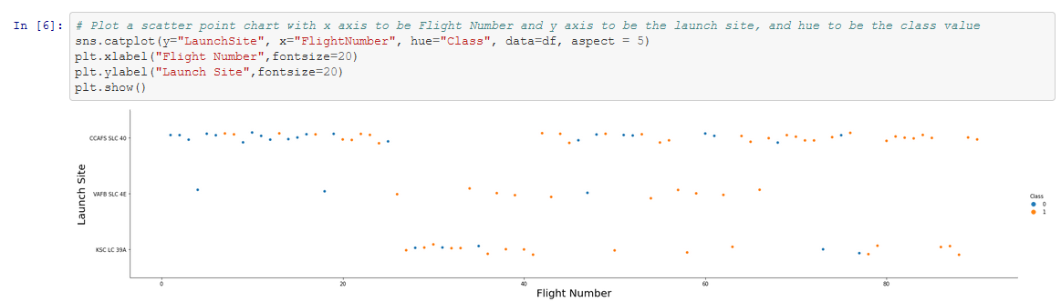
Flight Number vs. Launch Site
We can appreciate that with a higher flight number, there has been more success rate.

Slide 19
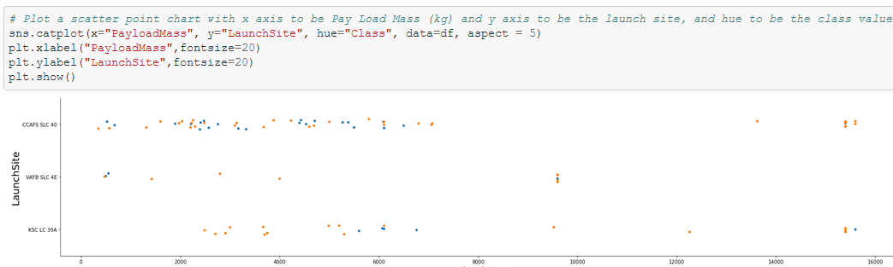
Payload vs. Launch Site
We can see that in VAFB SLC 4E There hasn’t been launchs with a higher payload tan 10000kg.
Also, Launches with higher Payloads tend to have higher success rates.

Slide 20
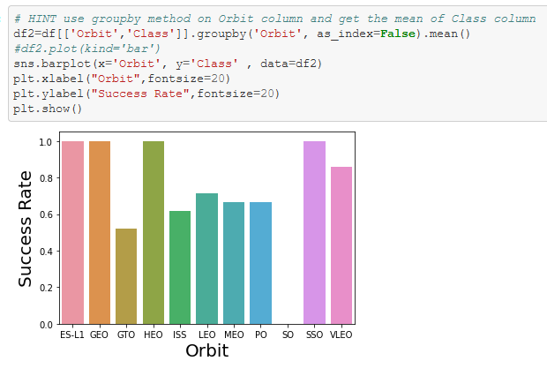
Success Rate vs. Orbit Type
GTO is the worst ORBIT for successful landings of first stage.

Slide 21
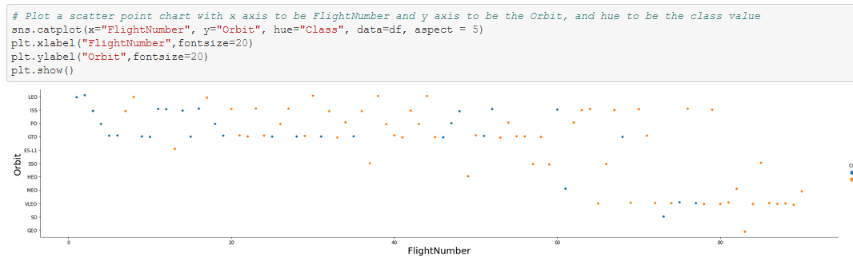
Flight Number vs. Orbit Type
VLEO, SO, GEO and MEO have Little data, and only in more recent Flight Numbers.

Slide 22
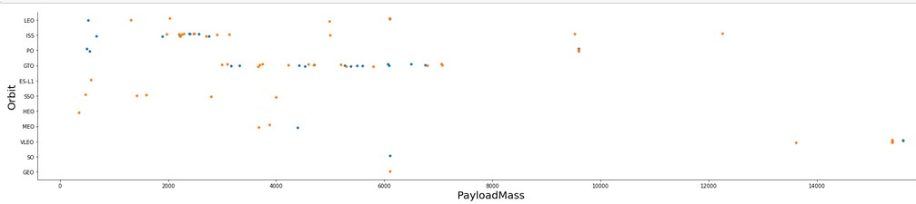
Payload vs. Orbit Type
Most launches have low payloads, and the ones with the highest payloads go to a VLEO Orbit.

Slide 23
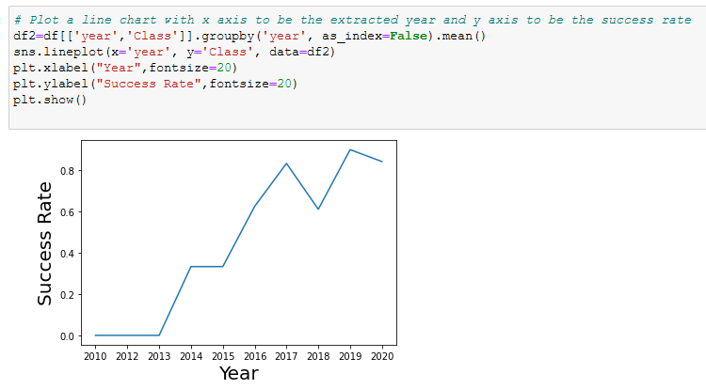
Launch Success Yearly Trend
Success Rate has skyrocketed with each passin year.

Slide 24
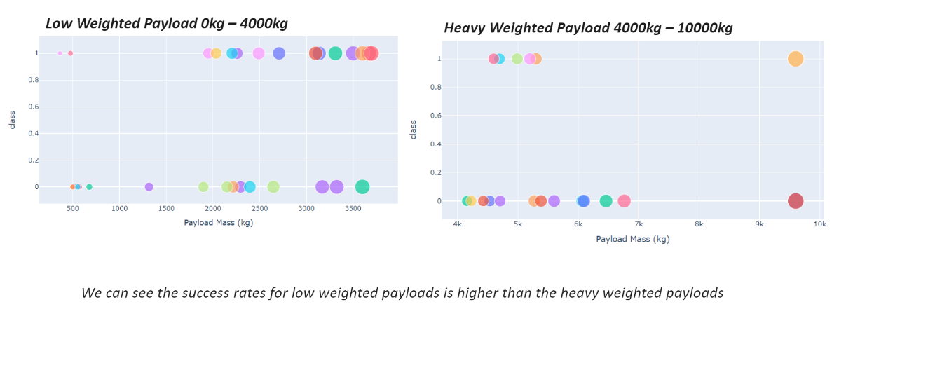
Low weighted payload vs Heavy payload
Show a scatter plot of Flight Number vs. Launch Site
Show the screenshot of the scatter plot with explanations

Slide 25


Slide 26
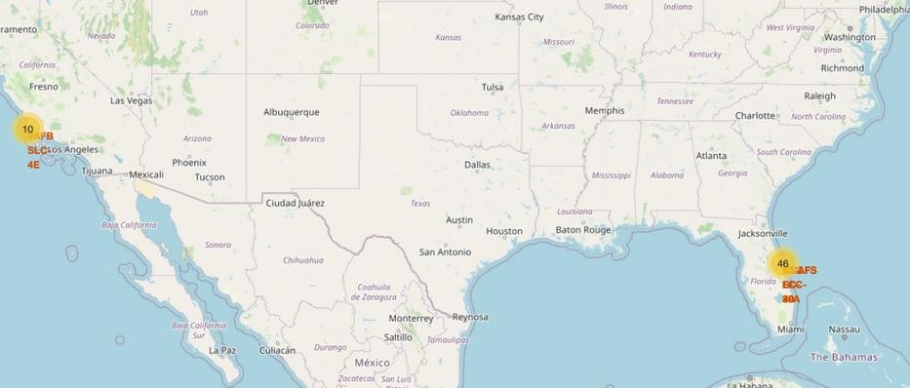
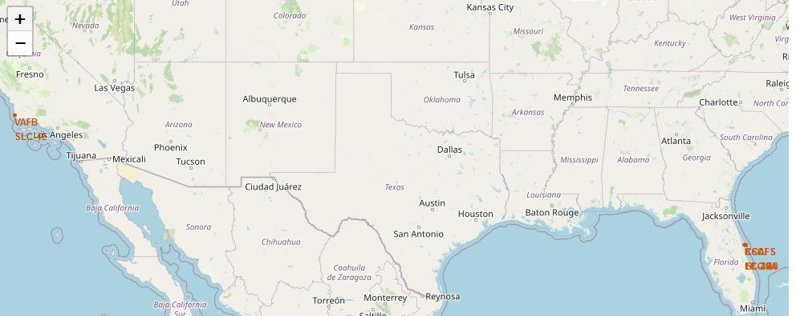
Launch Sites Map
Replace <Folium map screenshot 1> title with an appropriate title
Explore the generated folium map and make a proper screenshot to include all launch sites’ location markers on a global map
In this map, we can see all the Launch Sites
34

Slide 27
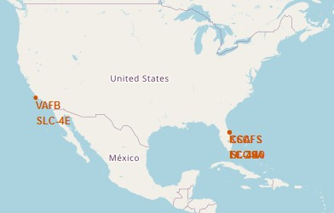
Folium Map Screenshot
Replace <Folium map screenshot 2> title with an appropriate title
Explore the folium map and make a proper screenshot to show the color-
labeled launch outcomes on the map
Explain the important elements and findings on the screenshot

Slide 28
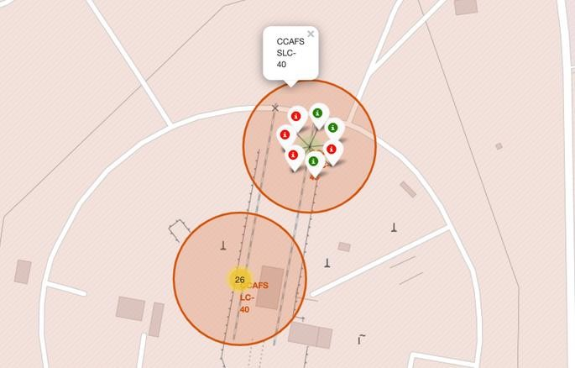
Folium Map Screenshot 3>
Replace <Folium map screenshot 3> title with an appropriate title
Explore the generated folium map and show the screenshot of a selected launch site to its proximities such as railway, highway, coastline, with distance calculated and displayed
Explain the important elements and findings on the screenshot

Slide 29
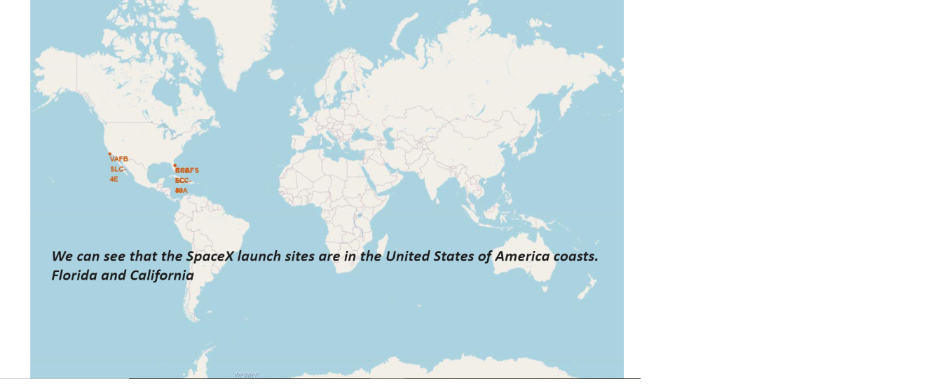
All Launch sites:-

Slide 30


Slide 31
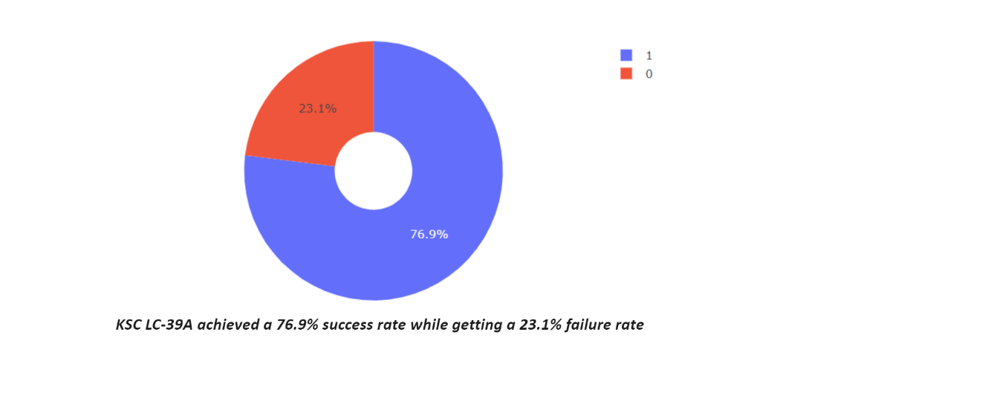
Total Success Launch Site:-

Slide 32
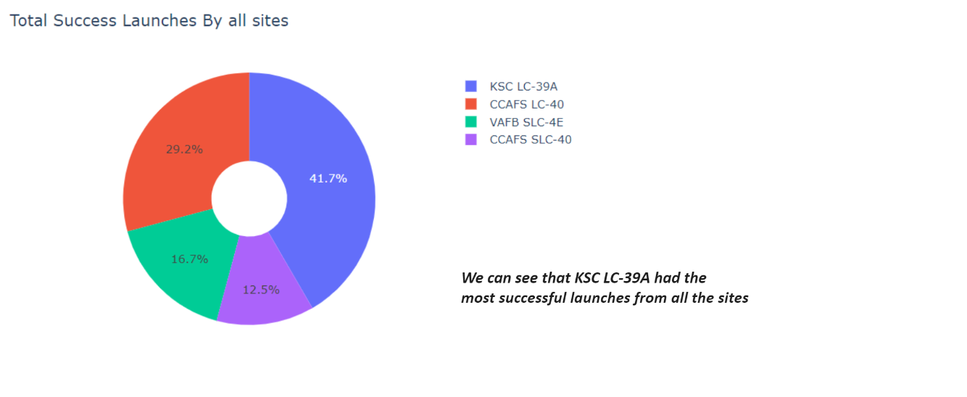
Highest Launch Site:-

Slide 33


Slide 34
Predative Analysis:-

Slide 35
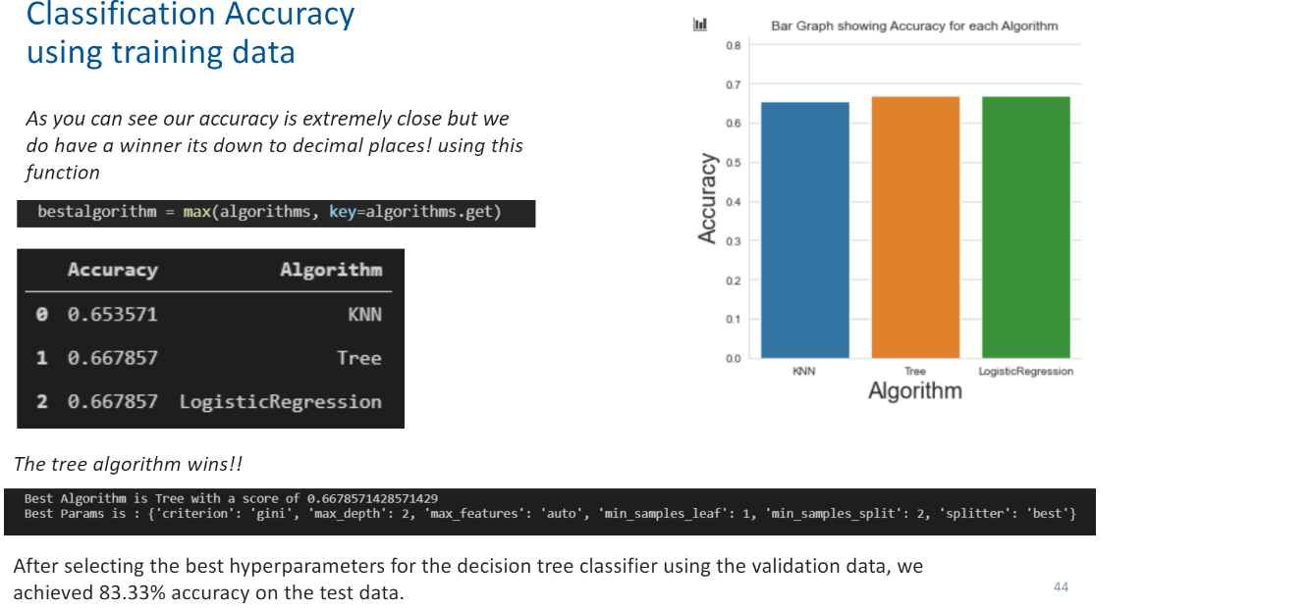

Slide 36
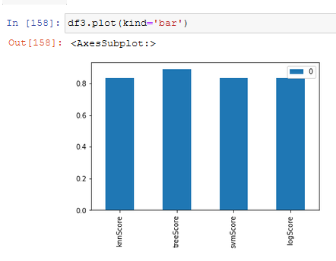
Classification Accuracy
The model with the highest accuracy was Decission Tree

Slide 37
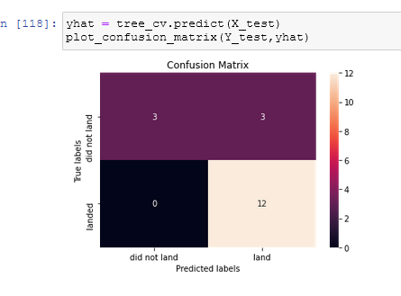
Confusion Matrix
For all the models, the confussion matrix showed 3 false possitives

Slide 38


